Slide 1
DIGITAL IMAGE PROCESSING
II. DIGITAL IMAGE FUNDAMENTALS

Slide 2
Table of Contents
Objectives
Structure of human eye
Image formation in the eye
Brightness adaptation in the eye
Brightness discrimination in the eye
Light and electromagnetic spectrum.
Image sensing and acquisition.
A simple image formation model.
Image sampling and quantization.

Slide 3

Objectives
This presentation has several objectives:
Understanding of important functions and limitations of human vision.
Understanding light, digital image creation, representation, basics of image sampling and quantization.
Get familiar with spatial intensity resolution and their effect on image appearance, basic geometric relationships between image pixels.
Get familiar with principal mathematical tools and apply various techniques in image processing.

Slide 4
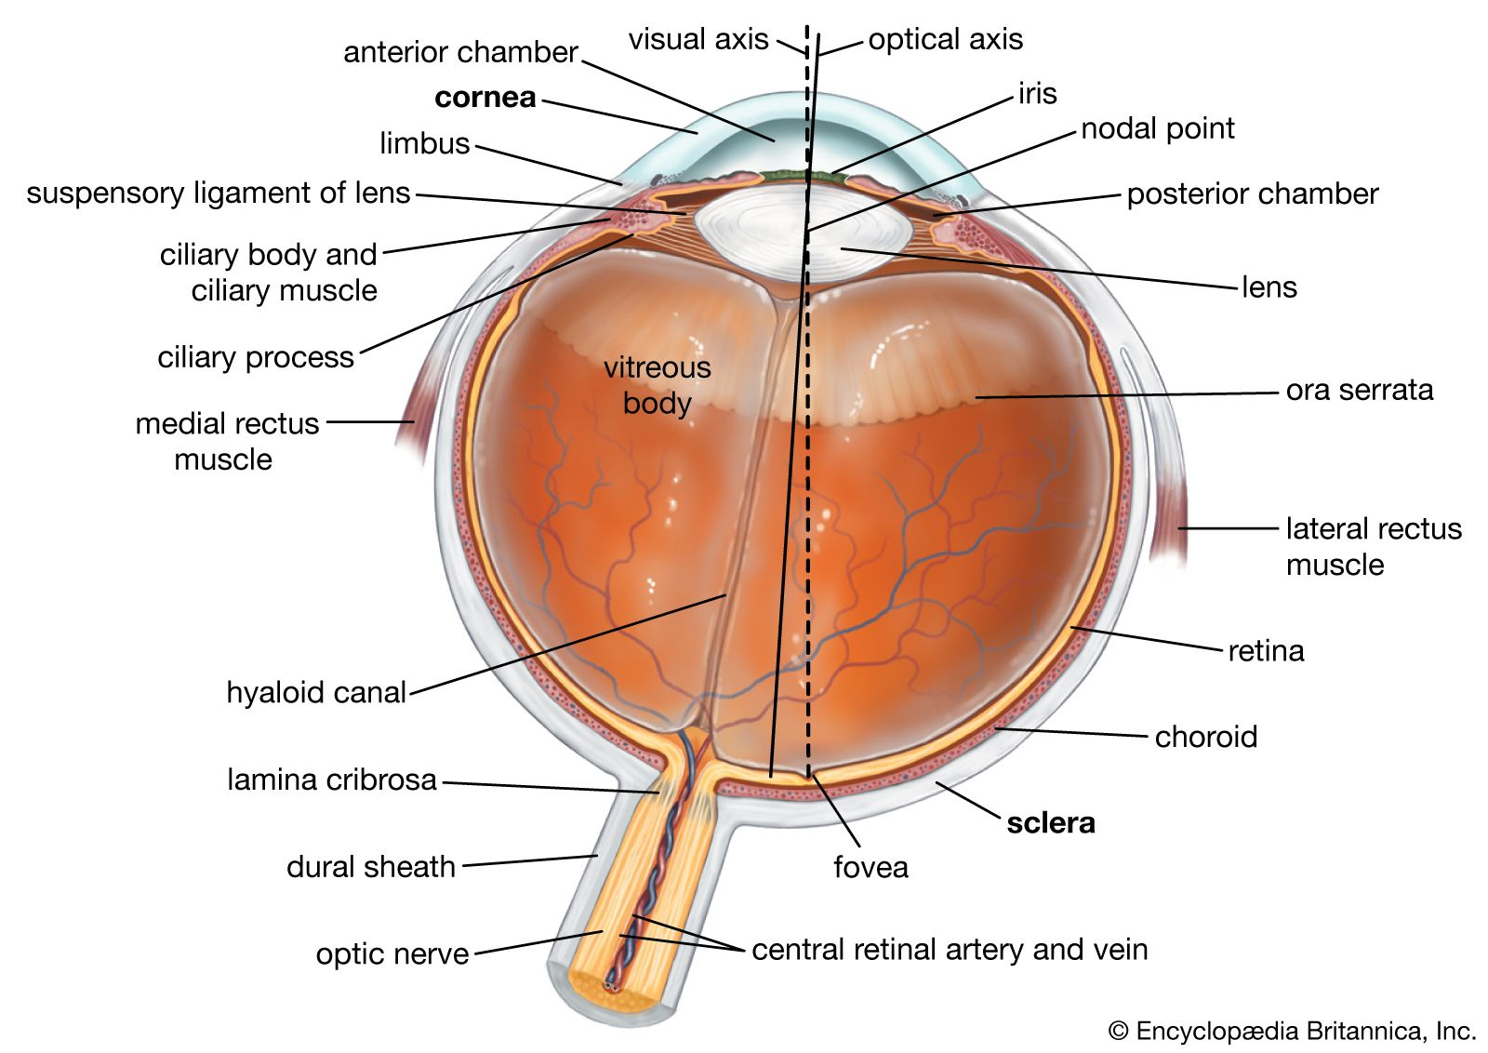
Structure of human eye
Figure shows a simplified cross section of human eye. The eye, sphere will a diameter of about 20mm, is enclosed by 3 membranes: cornea and sclera forming the outer cover; the choroid; and the retina.
Cornea: A tough transparent tissue that covers the anterior surface of the eye.
Sclera: An opaque membrane that is contiguous with cornea and encloses the remainder of the optic globe.
Image showing a cross section of the human eye.

Slide 5

Structure of a human eye:
The choroid, which lies below sclera, is heavily pigmented. Hence it helps reduce the amount of extraneous light entering the eye. At its anterior extreme, the choroid is divided into the ciliary body and the iris. Iris is the central opening, which varies the diameter of opening from 2mm to 8mm, hence controlling the amount of light entering the eye.
The lens consists of concentric layers of fibrous cells, and is suspended by fibres attached to the ciliary body.
The retina is the innermost membrane which lines the inside of the wall’s entire posterior portion. When the eye is focused, light from object is imaged on the retina. The vision is through two receptors: cones and rods.

Slide 6
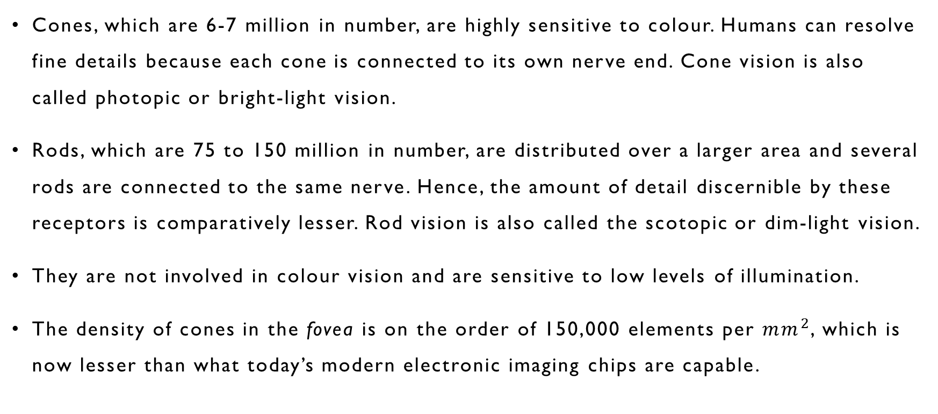
Structure of a human eye:
Cones, which are 6-7 million in number, are highly sensitive to colour. Humans can resolve fine details because each cone is connected to its own nerve end. Cone vision is also called photopic or bright-light vision.
Rods, which are 75 to 150 million in number, are distributed over a larger area and several rods are connected to the same nerve. Hence, the amount of detail discernible by these receptors is comparatively lesser. Rod vision is also called the scotopic or dim-light vision.
They are not involved in colour vision and are sensitive to low levels of illumination.
The density of cones in the fovea is on the order of 150,000 elements per ${mm}^{2}$, which is now lesser than what today’s modern electronic imaging chips are capable.

Slide 7
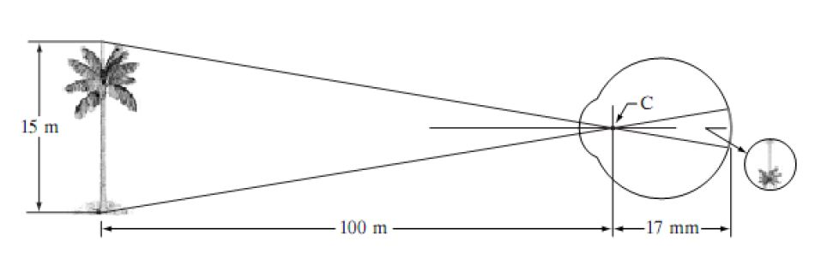
Image formation in the eye
In ordinary photographic camera, the lens has fixed focal length, and focusing at different distances is done by varying the distance between the lens and the imaging plane. The eye does the exact opposite. The distance between the lens and the retina remains constant, but rather the focal length of the lens is changed through the contraction and relaxation of the lens by the ciliary muscles. The range of focal length approximately varies from 14mm to 17mm, where the latter takes place when focused at distances greater than about 3m.
Image showing formation of image in human eye.

Slide 8
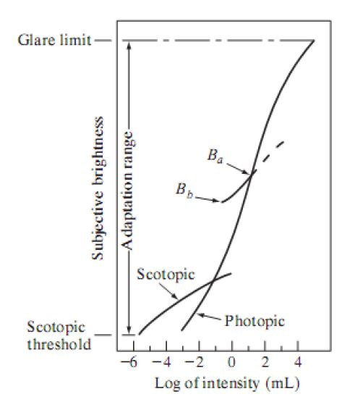
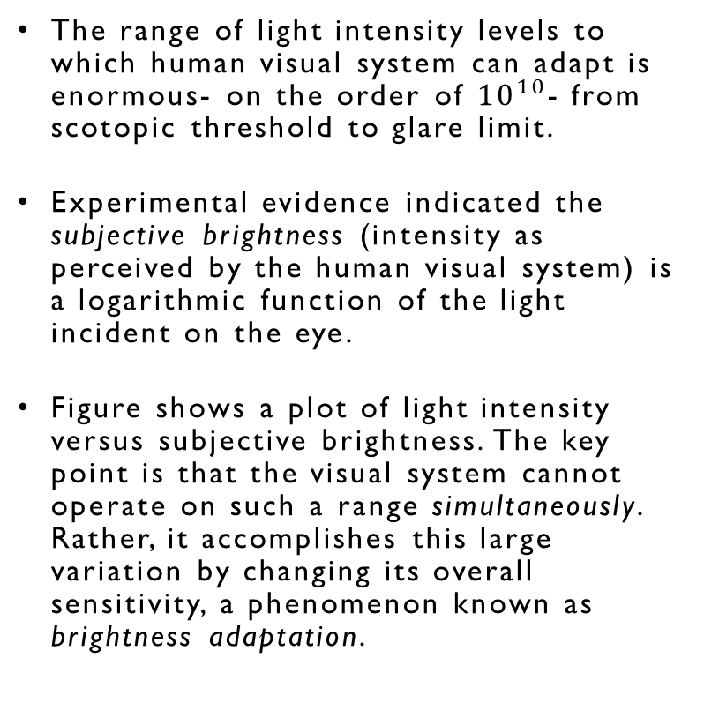
Brightness adaption in eye:
The range of light intensity levels to which human visual system can adapt is enormous- on the order of ${10}^{10}$- from scotopic threshold to glare limit.
Experimental evidence indicated the subjective brightness (intensity as perceived by the human visual system) is a logarithmic function of the light incident on the eye.
Figure shows a plot of light intensity versus subjective brightness. The key point is that the visual system cannot operate on such a range simultaneously. Rather, it accomplishes this large variation by changing its overall sensitivity, a phenomenon known as brightness adaptation.
Image showing plot of subjective brightness with log of intensity.

Slide 9

Title
Brightness adaptation and discrimination in the eye:
The total range of distinct intensity levels it can discriminate simultaneously is rather small when compared with the total adaptation range. For any given set of conditions, the current sensitivity level of the visual system is called the brightness adaptation level, which may correspond, for example, to brightness Ba in previous figure. The short intersecting curve represents the range of subjective brightness that the eye can perceive when adapted to this level. This range is rather restricted, having a level Bb at and below which all stimuli are perceived as indistinguishable blacks.
A classic experiment to determine capability of human visual system for brightness discrimination consists of having a subject look at a flat, uniformly illuminated area with intensity I large enough to occupy entire field of view and a small circular region illuminated with intensity I + ∆I.
Subtitle
Figure showing the basic experimental setup to characterize brightness discrimination

Slide 10
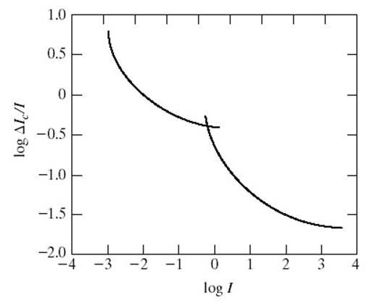
Brightness discrimination in the eye:
The minimum ∆I required for the subject to discriminate the different is noted and weber ratio, given ratio of ∆I and I, is noted.
The plot of weber ratio as function of intensity is given to the right.
This curve shows that brightness discrimination is poor at higher values of weber ratio (lower intensity) and it improves significantly at lower values of weber ratio (higher intensity)
A typical plot of the Weber ratio as function of intensity.

Slide 11
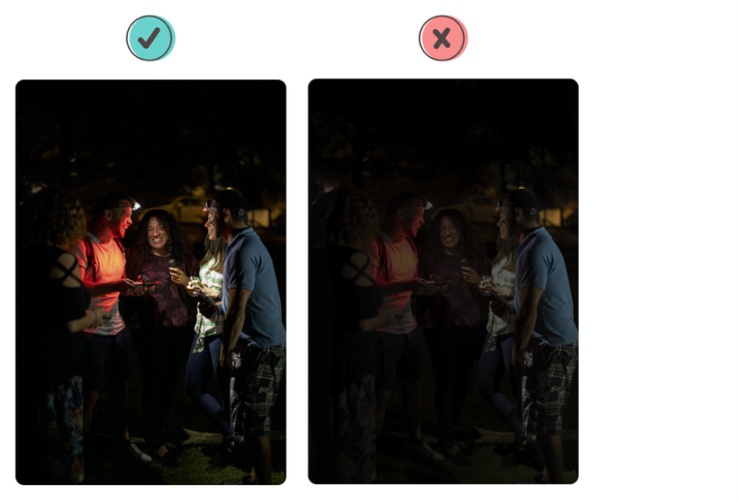
Low intensity v/s high intensity
The picture to the left clearly illustrates that at low intensity, we are unable to discriminate different intensities of the same/different colour in the right picture as easily as in the left picture.
The intensity of an radiated object is dependent on the illumination and reflection. It will be discussed in the later part of the presentation.

Slide 12
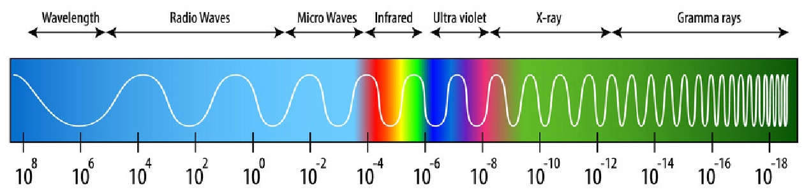
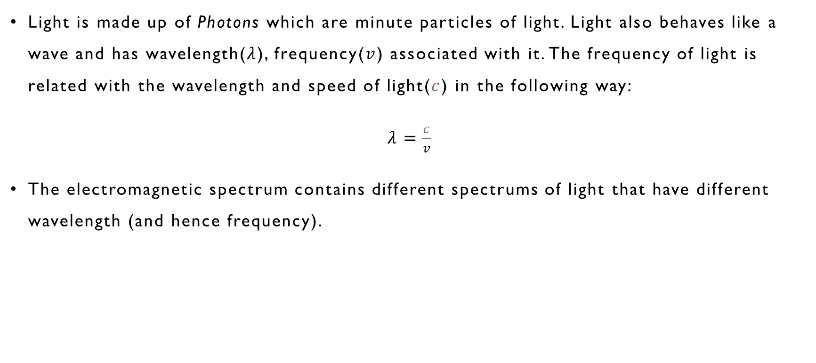
Light and the Electromagnetic spectrum:
Light is made up of Photons which are minute particles of light. Light also behaves like a wave and has wavelength($λ$), frequency($v$) associated with it. The frequency of light is related with the wavelength and speed of light($c$) in the following way:
$λ=\frac{c}{v}$
The electromagnetic spectrum contains different spectrums of light that have different wavelength (and hence frequency).

Slide 13
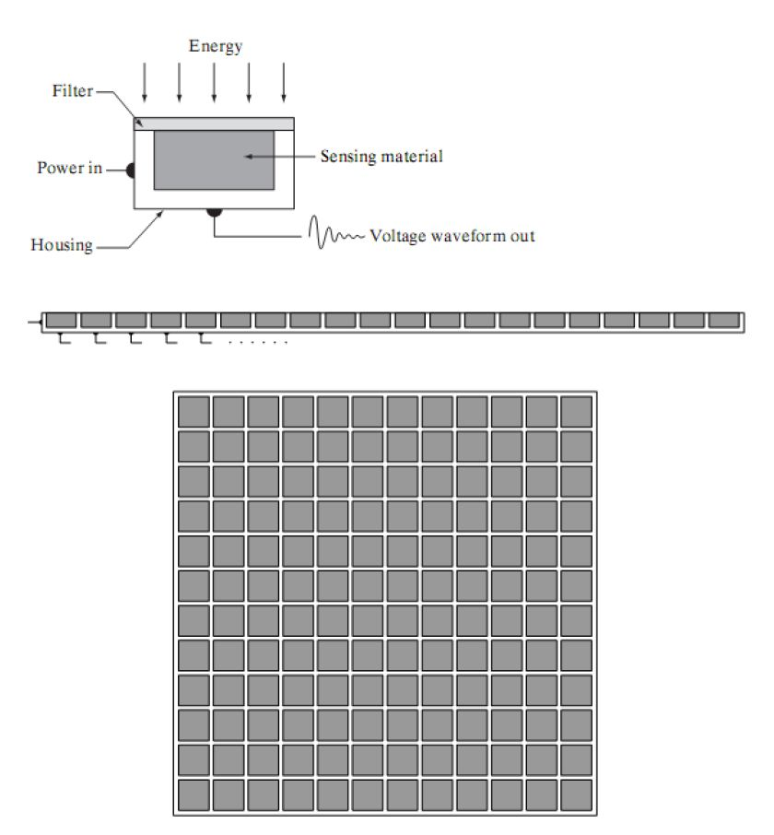
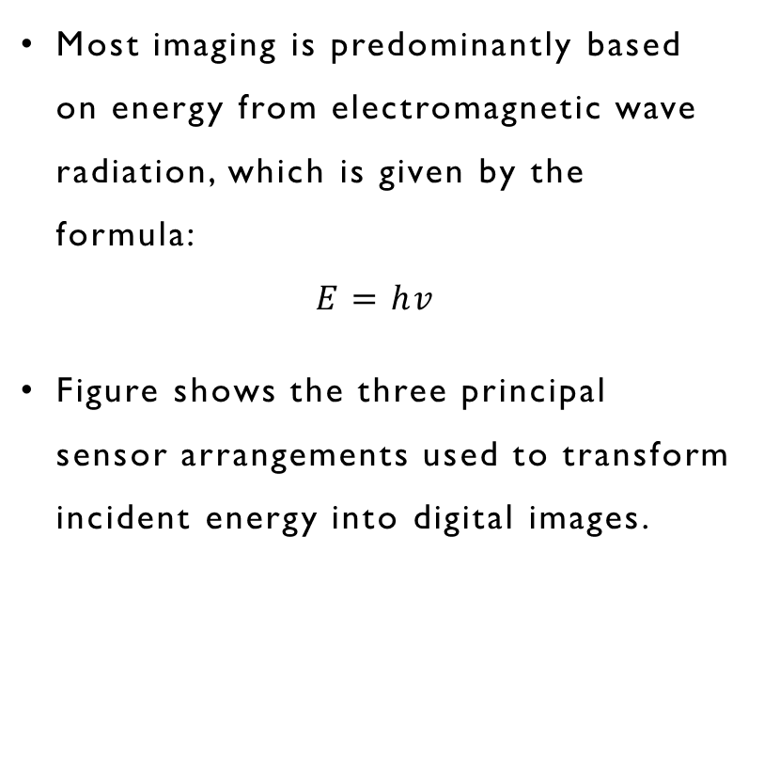
Image sensing and acquisition
Most imaging is predominantly based on energy from electromagnetic wave radiation, which is given by the formula:
$$E=hv$$
Figure shows the three principal sensor arrangements used to transform incident energy into digital images.
Image showing different sensor arrangements (1) Single sensing element (2) Line sensor (3) Array sensor.

Slide 14
Image sensing and acquisition
The idea is simple: Incoming energy is transformed into a voltage by a combination of electrical power and sensor material that is responsive to the type of energy being detected.
The output voltage waveform is the response of the sensor, and a digital quantity is obtained by digitizing that response.
The figure before shows the components of a single sensing element. A familiar sensor of this type is the photodiode, which is constructed by silicon materials and whose output is a voltage proportional to light intensity. Using a filter in front of the sensor improves its selectivity and hence gives capability to measure the intensity of a particular type of light.

Slide 15
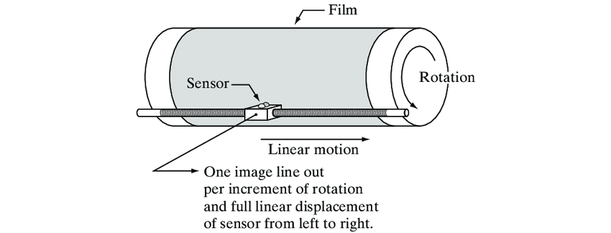
Title
Image acquisition using a single element
In order to generate a 2D image using a single sensing element, there has to be relative displacements along x and y directions, like the apparatus shown below.
This method is an inexpensive way, wherein the light source is placed inside the drum whose mechanical motion provides displacement in one direction. The sensor is mounted on a lead screw that provides motion in the perpendicular direction. A negative film is present on the drum circumference that modifies the light intensity before getting captured by the sensor and converted to voltage variations, ultimately converted to image intensity levels by digitization.
Subtitle

Slide 16
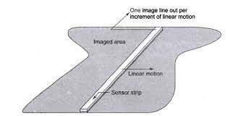
Title
Image acquisition using sensor strips
A geometry that is used much more frequently than single sensors consists of an in-line arrangement of sensors in the form of a sensor strip. The strip provides imaging elements in one direction. Motion perpendicular to the strip provides imaging in the other direction, as shown in Fig.
This arrangement is used in most flat-bed scanners, and also in airborne imaging applications where aircraft mounted with this arrangement, flies over an constant altitude.
Subtitle

Slide 17
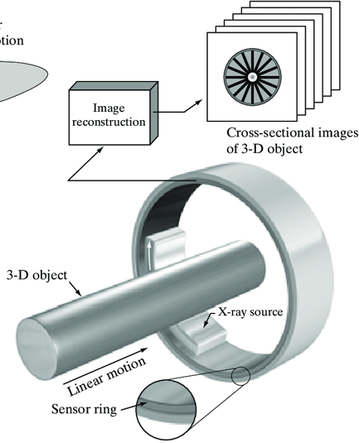
Image acquisition using sensor strips
Sensor strips can also be in ring configuration as shown in the figure, which is used in medical and industrial imaging to obtain cross-sectional (“slice”) images of 3-D objects.
A rotating X-ray source provides illumination, and X-ray sensitive sensors opposite the source collect the energy that pass through the object.
This is the basis for medical and industrial computerized axial tomography (CAT) imaging. The output of sensors is processed by reconstruction algorithms whose objective is to transform the sensed data into meaningful cross-sectional images.

Slide 18
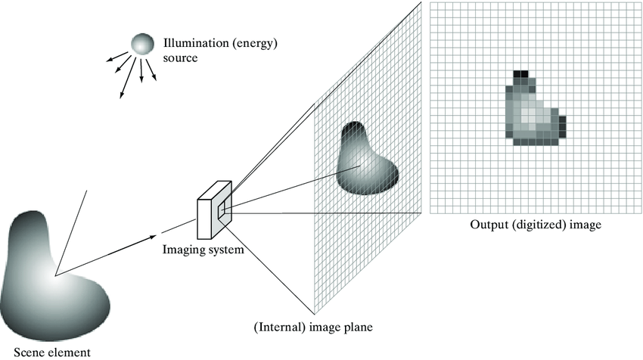
Image acquisition using sensor arrays
The individual sensing elements in electromagnetic and ultrasonic sensing devices are frequently arranged in the form of 2-D array.
The response of each sensor is proportional to the integral of the light energy projected onto the surface of the sensor, a property that is used in astronomical and other applications requiring low noise images.
The key advantage of sensor arrays is that complete image can be obtained by focusing the energy pattern onto the surface of the array, motion is obviously not necessary.
The image system focuses the image onto the sensor array, which coincides with the focal plane of the lens of image system, that produces outputs proportional to the integral of the light received at each sensor, that is digitized.

Slide 19
A simple image formation model
We denote images by two-dimensional functions of the form f(x,y). The value of f at spatial coordinates (x,y) is a scalar quantity whose physical meaning determined by the source of the image, and whose values are proportional to energy radiated by physical source (e.g., electromagnetic waves) .As a consequence, f(x,y) must be non-negative and finite.
A function f(x,y) is characterized by two components:
The amount of source illumination incident on the scene being viewed.
The amount of illumination reflected by the object in the scene.
These are called the illumination and reflectance components, denoted by i(x,y) and r(x,y). The two function combine as a product to form f(x,y).

Slide 20
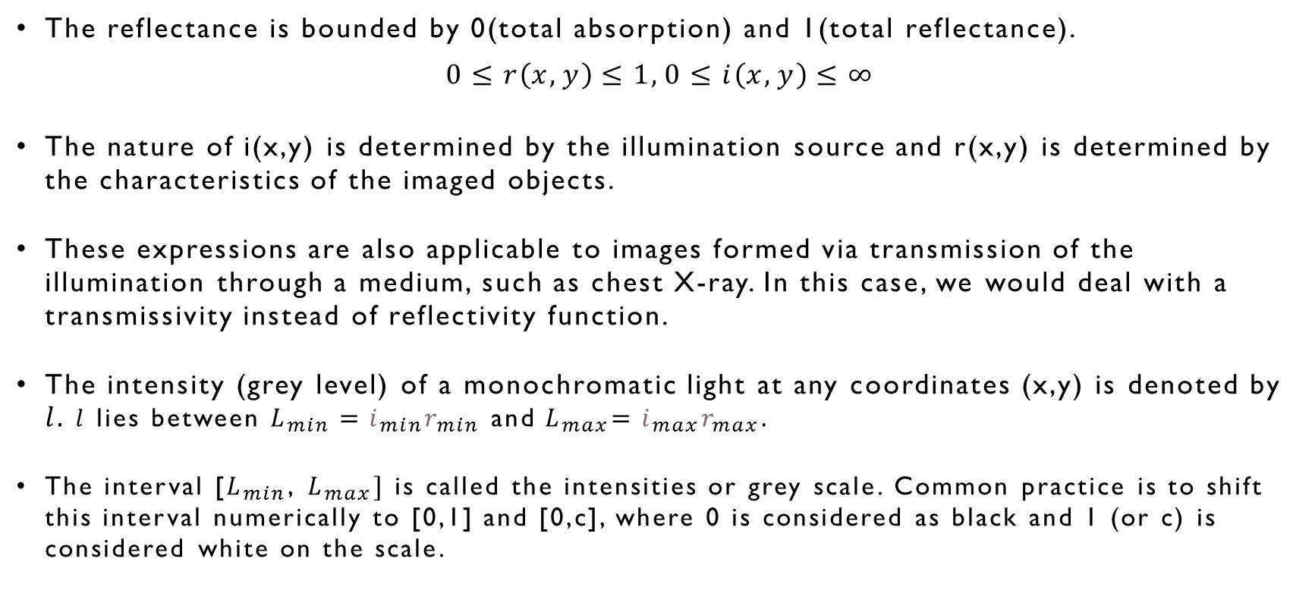
A simple image formation model
The reflectance is bounded by 0(total absorption) and 1(total reflectance).
$$0≤r\left(x,y\right)≤1, 0≤i\left(x,y\right)≤∞$$
The nature of i(x,y) is determined by the illumination source and r(x,y) is determined by the characteristics of the imaged objects.
These expressions are also applicable to images formed via transmission of the illumination through a medium, such as chest X-ray. In this case, we would deal with a transmissivity instead of reflectivity function.
The intensity (grey level) of a monochromatic light at any coordinates (x,y) is denoted by $l.$ $l$ lies between $L_{min}=i_{min}r_{min}$ and${ L}_{max}=i_{max}r_{max}.$
The interval [$L_{min}$, $L_{max}]$ is called the intensities or grey scale. Common practice is to shift this interval numerically to [0,1] and [0,c], where 0 is considered as black and 1 (or c) is considered white on the scale.

Slide 21

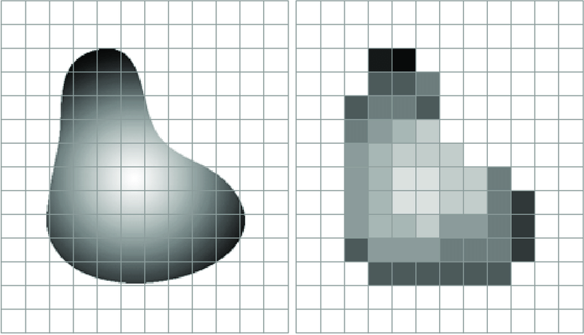
Image sampling and quantization
There are numerous ways to acquire images but our objective in all is to generate digital image from sensed data. The output of the most sensors is a continuous voltage waveform.
To create a digital image, we need to convert the continuous sensed data into a digital format. This requires two processes:
Sampling
Quantization.
Image showing (a) Continuous image projected onto sensor array
(b) The result of image sampling and quantization.

Slide 22
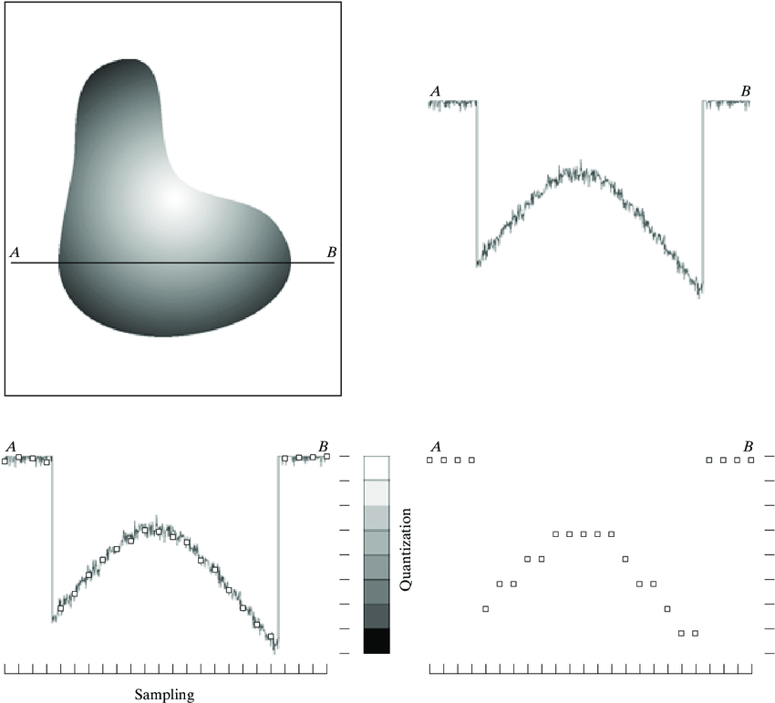
Basic concepts in sampling and quantization
An image maybe continuous with respect to x- and y- coordinates, and also in amplitude. To digitalise it, we have to sample the function in both coordinates and also in amplitude.
Digitalisation of coordinates in called sampling, whereas digitalisation of values is called quantization.
To sample an image, we take equally spaced samples along a line through the image. The set of the samples constitute the sample function.
The intensity levels of the sensed image are continuous, so in order to convert into digital form, it must be quantized into discrete quantities.
(a) Continuous image (b) A scan-line showing intensity variations along AB in the continuous image (c) Sampling and quantization (d) Digital scan-line.

Slide 23
Title
Representing digital images
Let f(s, t) represent a continuous image function of two continuous variables, s and t. We convert this function into a digital image by sampling and quantization.
Suppose that we sample the continuous image into a digital image, f(x, y), containing M rows and N columns, where (x, y) are discrete coordinates. For notational clarity and convenience, we use integer values for these discrete coordinates: x = 0, 1, 2,..., M-1 and y = 0,1, 2,..., N-1.
Thus, for example, the value of the digital image at the origin is f(0,0), and its value at the next coordinates along the first row is f(0, 1). Here, the notation (0, 1) is used to denote 2nd sample along firs row.
In general, the value of the digital image at any coordinate (x,y) is denoted by f(x,y), where x and y are integers. The section of the real plane spanned by the coordinates of the image is called spatial domain with x and y being referred to as spatial variables or spatial coordinates.
Subtitle

Slide 24
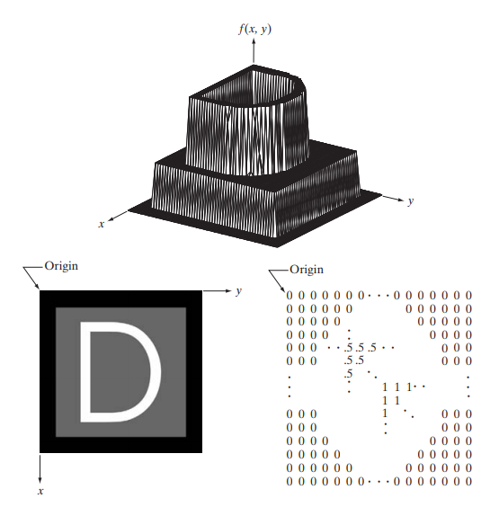
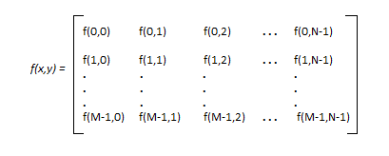
Representing digital images
Figure (a) is a plot of the function, with two axes determining spatial location and third axis being the values of f(x,y).
Figure (b) is the most common representation. It shows f(x,y) as it would appear on a computer display or photograph where the intensity at each point in the display is proportional to the value of f at that point.
Figure (c) is an array representation composed of numerical values of f(x,y). This is the representation used for computer processing. In equation form, we write the representation of an MXN numerical array as:
Each element of the array is called an image element, picture element, pixel or pel.
(a) Image plotted as a surface. (b) Image displayed as a visual intensity array (c) Image shown as 2-D numerical array.

Slide 25
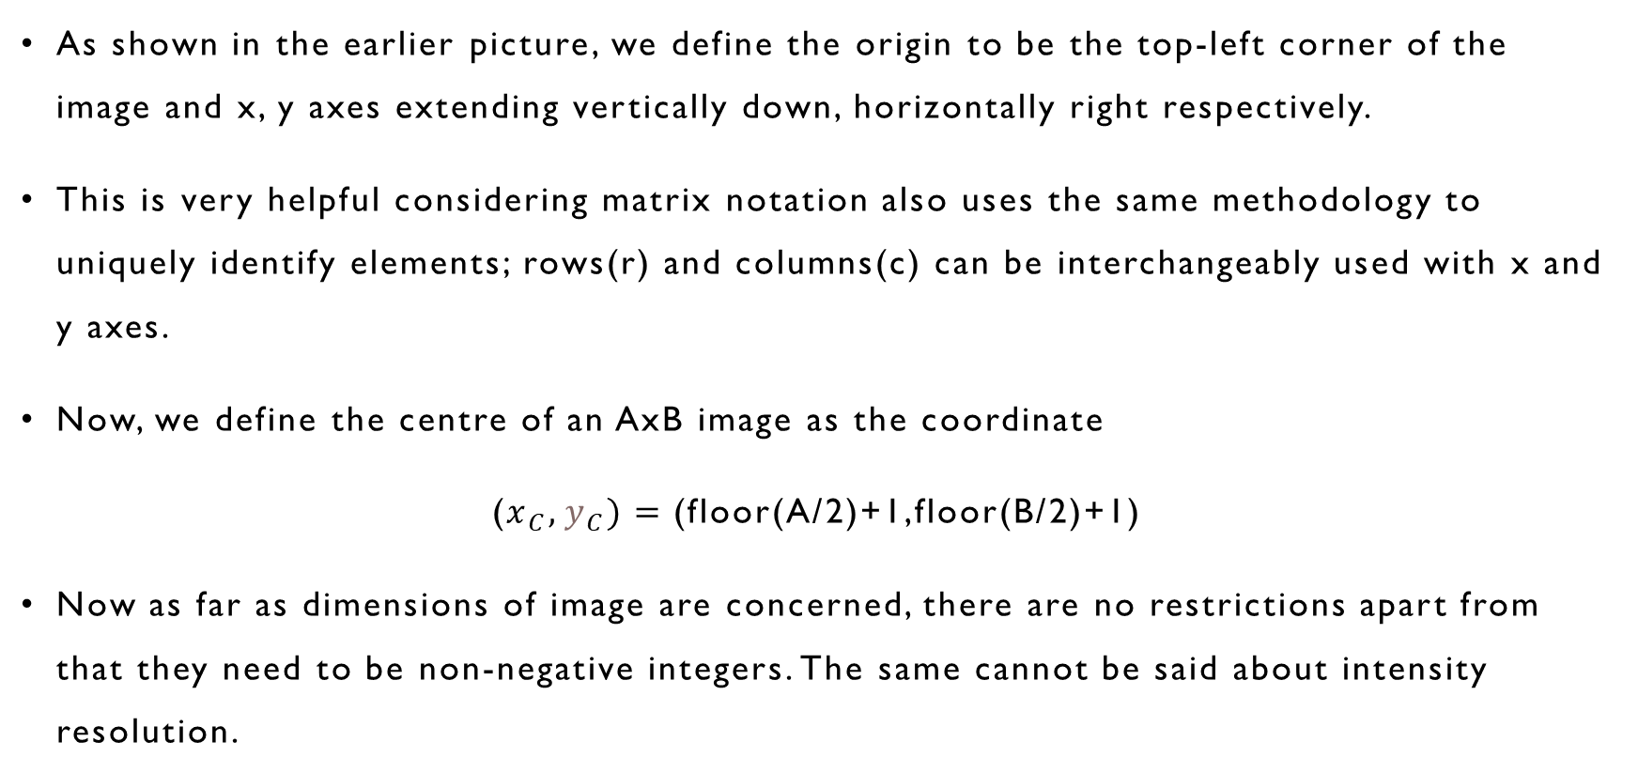
Title
Representing digital images
As shown in the earlier picture, we define the origin to be the top-left corner of the image and x, y axes extending vertically down, horizontally right respectively.
This is very helpful considering matrix notation also uses the same methodology to uniquely identify elements; rows(r) and columns(c) can be interchangeably used with x and y axes.
Now, we define the centre of an AxB image as the coordinate
($x_{C},y_{C})=$(floor(A/2)+1,floor(B/2)+1)
Now as far as dimensions of image are concerned, there are no restrictions apart from that they need to be non-negative integers. The same cannot be said about intensity resolution.
Subtitle

Slide 26
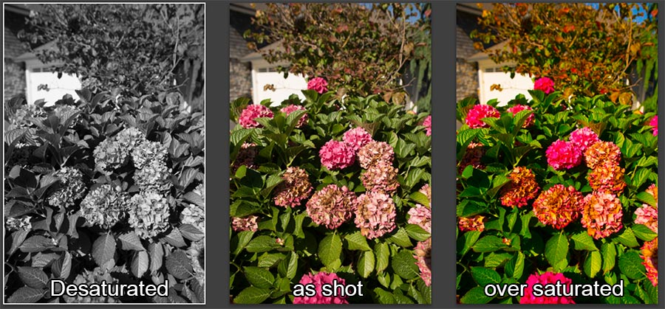
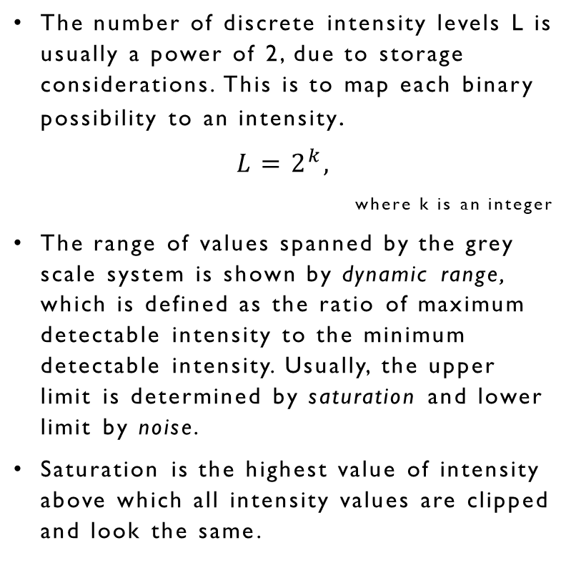
Representing digital images
The number of discrete intensity levels L is usually a power of 2, due to storage considerations. This is to map each binary possibility to an intensity.
$$L=2^{k},$$
where k is an integer
The range of values spanned by the grey scale system is shown by dynamic range, which is defined as the ratio of maximum detectable intensity to the minimum detectable intensity. Usually, the upper limit is determined by saturation and lower limit by noise.
Saturation is the highest value of intensity above which all intensity values are clipped and look the same.
Figure showing the comparison between unsaturated, normal, and over saturated images. (Source: Omnilargess Photography Classes).

Slide 27
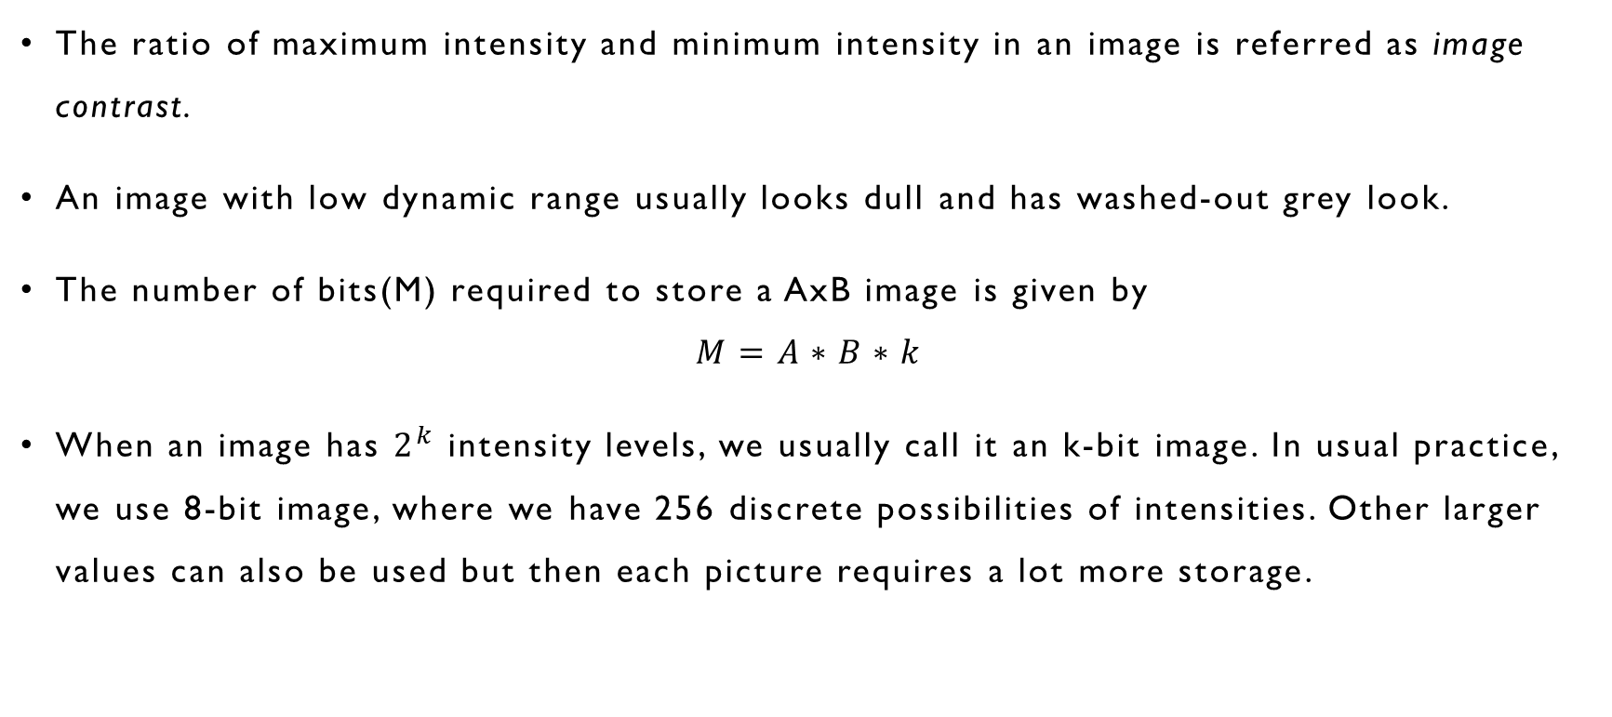
Representing digital images
The ratio of maximum intensity and minimum intensity in an image is referred as image contrast.
An image with low dynamic range usually looks dull and has washed-out grey look.
The number of bits(M) required to store a AxB image is given by
$$M=A∗B∗k$$
When an image has $2^{k}$ intensity levels, we usually call it an k-bit image. In usual practice, we use 8-bit image, where we have 256 discrete possibilities of intensities. Other larger values can also be used but then each picture requires a lot more storage.

Slide 28
Representing digital images
The ratio of maximum intensity and minimum intensity in an image is referred as image contrast.
An image with low dynamic range usually looks dull and has washed-out grey look.
The number of bits(M) required to store a AxB image is given by
$$M=A∗B∗k$$
When an image has $2^{k}$ intensity levels, we usually call it an k-bit image. In usual practice, we use 8-bit image, where we have 256 discrete possibilities of intensities. Other larger values can also be used but then each picture requires a lot more storage.

Slide 29
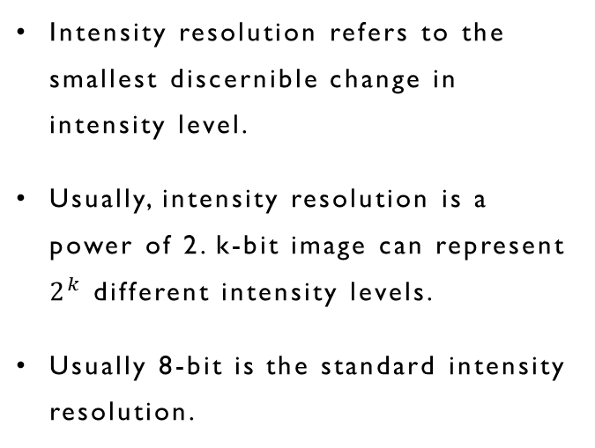
Spatial vs Intensity Resolution
Spatial Resolution
Intensity resolution
Spatial resolution is a measure of the smallest discernible detail in an image and is quantitatively measured with line pairs per unit distance or dots(pixels) per unit distance.
Dots per inch (dpi) is a common for measuring spatial resolution. Newspapers are printed at 75 dpi.
Intensity resolution refers to the smallest discernible change in intensity level.
Usually, intensity resolution is a power of 2. k-bit image can represent $2^{k}$ different intensity levels.
Usually 8-bit is the standard intensity resolution.

Slide 30


A 92-dpi image
A 46-dpi image (using nni**)
*generated using opencv library of python. **nni- Nearest Neighbour Interpolation.

Slide 31

A 8-bit image
A 4-bit image
*generated using opencv library of python.

Slide 32
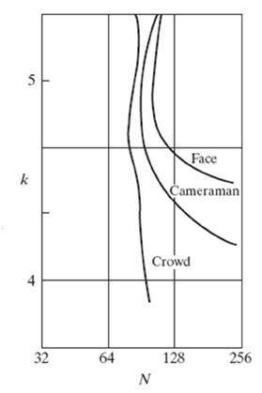
Isopreference curves
An experiment conducted by Huang[1965] attempted to quantify experimentally the effects on image quality by variation of spatial and intensity resolution with different set of pictures: some having very low amount of detail, some moderate and some high amount of detail.
The results were summarized in the famous isopreference curves in Nk plane, where points lying on the same curve correspond to same subjective quality.
The graph clearly suggests that less number of intensity levels are required for images with more amount of detail.
Isopreference curves. (Source Huang[1965])

Slide 33
Image Interpolation
Image interpolation, which is used in zooming, shrinking, rotating, and geometrically correcting images, is a process in which values at unknown locations are estimated with those of the known.
An example is increasing the resolution of a certain image.
There are 3 main interpolation techniques:
Nearest Neighbor Interpolation
Bilinear Interpolation
Bicubic Interpolation

Slide 34
Nearest Neighbor Interpolation
In this type of interpolation, the value of pixel is taken as the known value of the pixel nearest to it.
This method is simple and easy to implement but it can produce distortion of straight lines and curves.
No new value of intensity is created but rather the values which are already present are used for the new pixels.
The pictures in the next slide clearly illustrate this phenonmenon.

Slide 35


(a) Original Image
(b) Image scaled using NNI

Slide 36
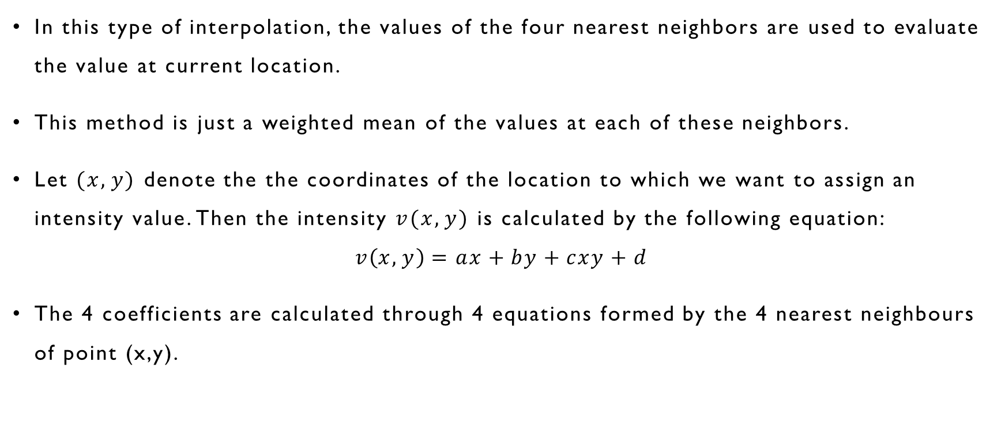
Bilinear Interpolation
In this type of interpolation, the values of the four nearest neighbors are used to evaluate the value at current location.
This method is just a weighted mean of the values at each of these neighbors.
Let $(x,y)$ denote the the coordinates of the location to which we want to assign an intensity value. Then the intensity $v(x,y)$ is calculated by the following equation:
$$v\left(x,y\right)=ax+by+cxy+d$$
The 4 coefficients are calculated through 4 equations formed by the 4 nearest neighbours of point (x,y).

Slide 37

(a) Original Image
(b) Image scaled using BLI

Slide 38
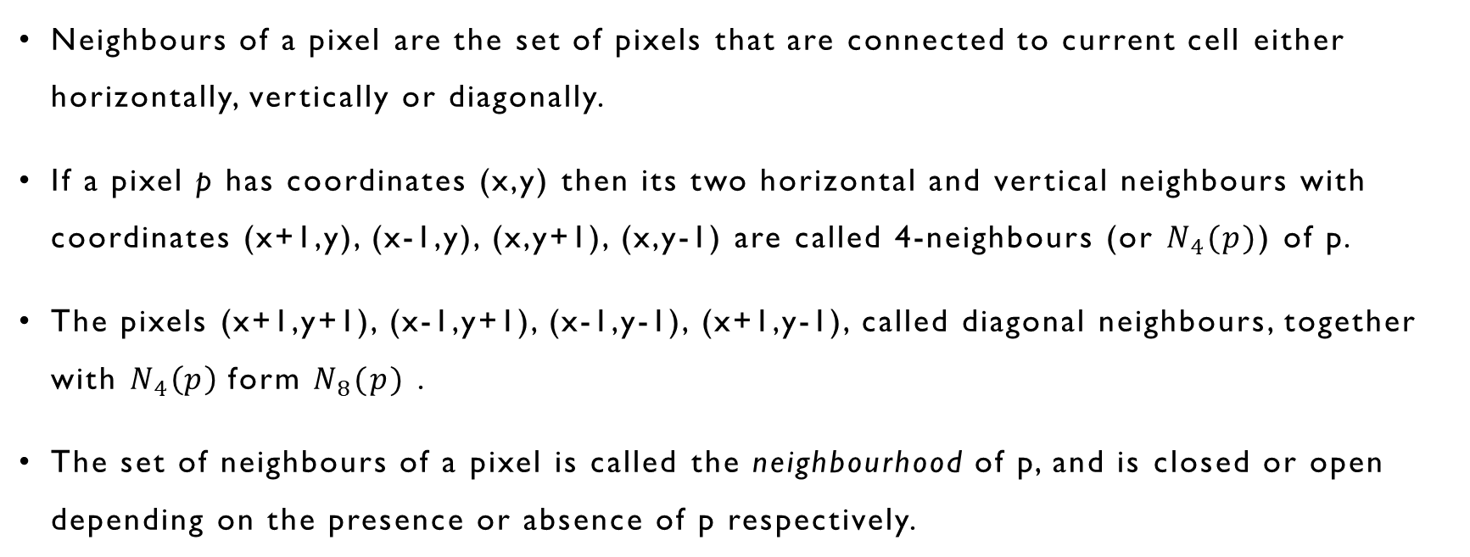
Title
Some Basic Relationships between pixels
Neighbours of a pixel are the set of pixels that are connected to current cell either horizontally, vertically or diagonally.
If a pixel p has coordinates (x,y) then its two horizontal and vertical neighbours with coordinates (x+1,y), (x-1,y), (x,y+1), (x,y-1) are called 4-neighbours (or $N_{4}(p)$) of p.
The pixels (x+1,y+1), (x-1,y+1), (x-1,y-1), (x+1,y-1), called diagonal neighbours, together with $N_{4}\left(p\right)$ form $N_{8}(p)$ .
The set of neighbours of a pixel is called the neighbourhood of p, and is closed or open depending on the presence or absence of p respectively.
Subtitle

Slide 39
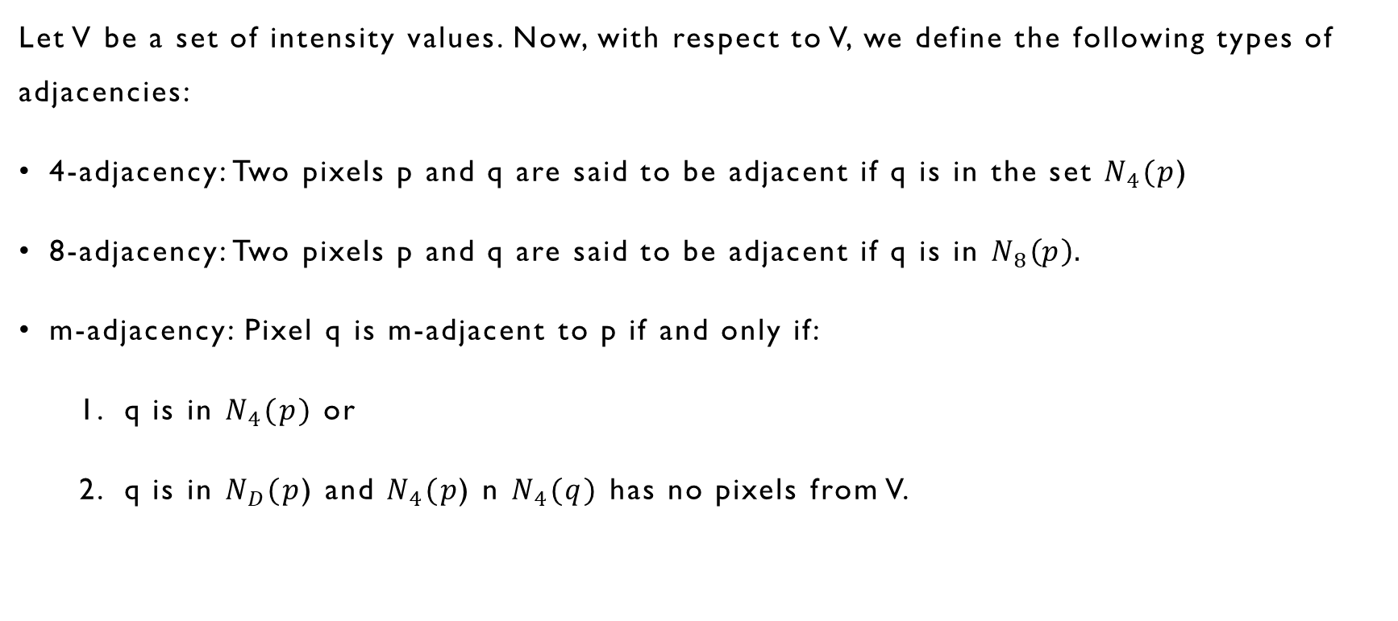
Adjacency of Pixel
Let V be a set of intensity values. Now, with respect to V, we define the following types of adjacencies:
4-adjacency: Two pixels p and q are said to be adjacent if q is in the set $N_{4}(p$)
8-adjacency: Two pixels p and q are said to be adjacent if q is in $N_{8}\left(p\right).$
m-adjacency: Pixel q is m-adjacent to p if and only if:
q is in $N_{4}(p)$ or
q is in $N_{D}(p$) and $N_{4}(p$) n $N_{4}(q)$ has no pixels from V.

Slide 40
Title
Other Relationships of pixel
Path: Two pixels p and q are connected in set S, if there exists a path between them entirely made up of pixels in S. We can define 4-,8-,m- paths.
Connected Component: For any pixel p, the set of pixels connected to it in S is called a connected component.
Connected set: If only one connected component of S is present in an image, then S is called connected set.
Region: A region of an image is a subset of pixels that is a connected set. Two regions i and j are adjacent if their union forms a connected set. Regions that are not adjacent are called disjoint. Usually 4-,8- adjacency is used.
Subtitle

Slide 41
Title
Other Relationships of pixel
Complement: If we take set of all pixels in an image as universal set, then complement of a region R is the set of pixels that are in universal set but not in R. The points in R are called foreground and the ones present in complement the background
Boundary or contour: The set of pixels in R that have at least one background neighbor. Usually 8-adjacency is used. This border is also called inner border and the corresponding border in the background is called outer border.
The concept of edge is context-dependent and it doesn’t have a “global” definition like the above terms have.
Subtitle

Slide 42
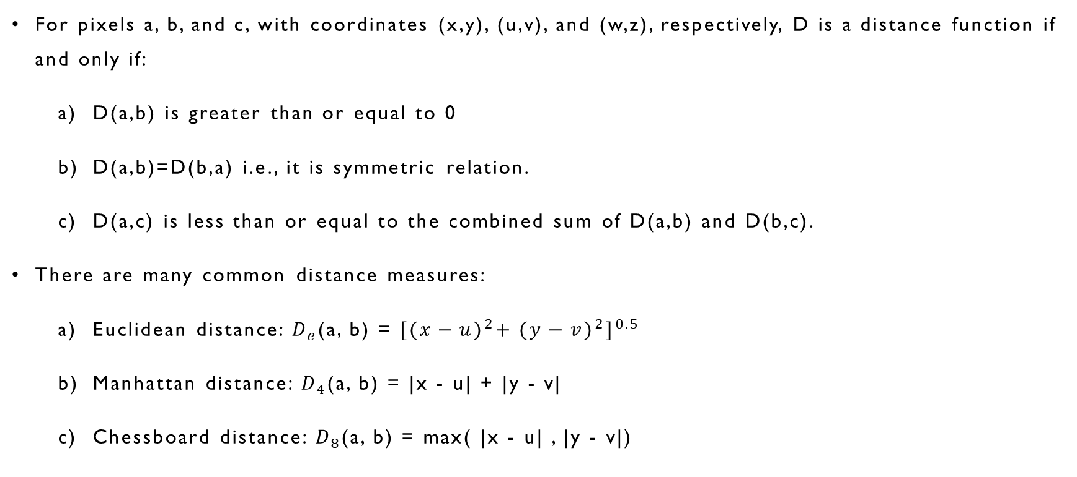
Distance Measures
For pixels a, b, and c, with coordinates (x,y), (u,v), and (w,z), respectively, D is a distance function if and only if:
D(a,b) is greater than or equal to 0
D(a,b)=D(b,a) i.e., it is symmetric relation.
D(a,c) is less than or equal to the combined sum of D(a,b) and D(b,c).
There are many common distance measures:
Euclidean distance: $D_{e}$(a, b) = ${[{(x−u)}^{2}+ {(y−v)}^{2}]}^{0.5}$
Manhattan distance: $D_{4}$(a, b) = |x - u| + |y - v|
Chessboard distance: $D_{8}$(a, b) = max( |x - u| , |y - v|)

Slide 43
Thank You

